Slide 1
Groww Chatbot
ANINDYA SADHUKHAN
Manish Kumar

Slide 2
Introduction
This is a contextual chat bot which is based on REST API architecture
Contextual means that It’ll interact with user based on the current context of the page the user is currently at.
This improves the user experience and help users understand flow of the application
This chat bot can be integrated with any web app.
Tech Stack used for this project =>
[ Node.Js , Express.JS, MongoDB , React.Js ]

Slide 3
DECISION TREE

Slide 4
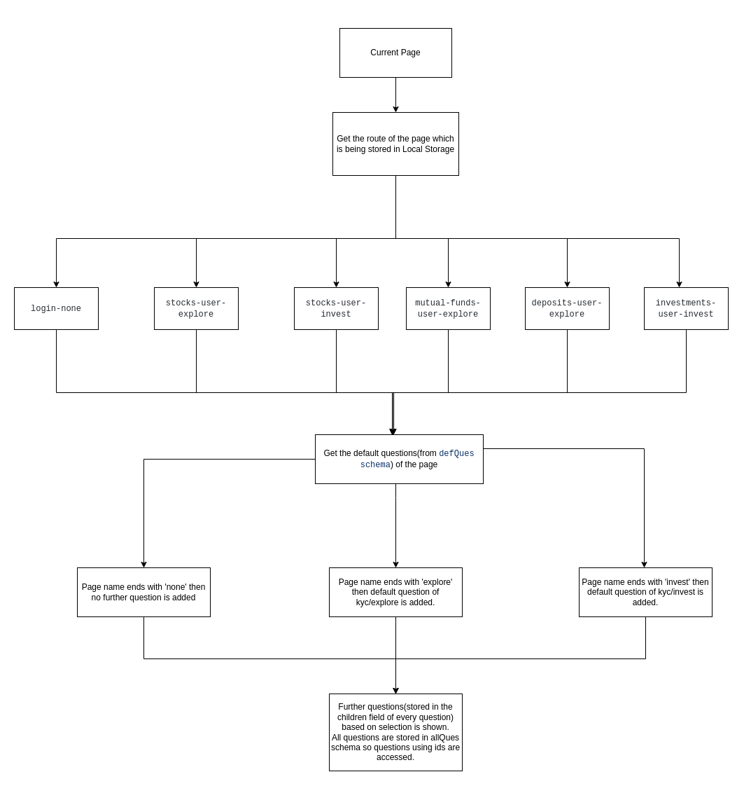

Slide 5
DATABASE DESIGN

Slide 6
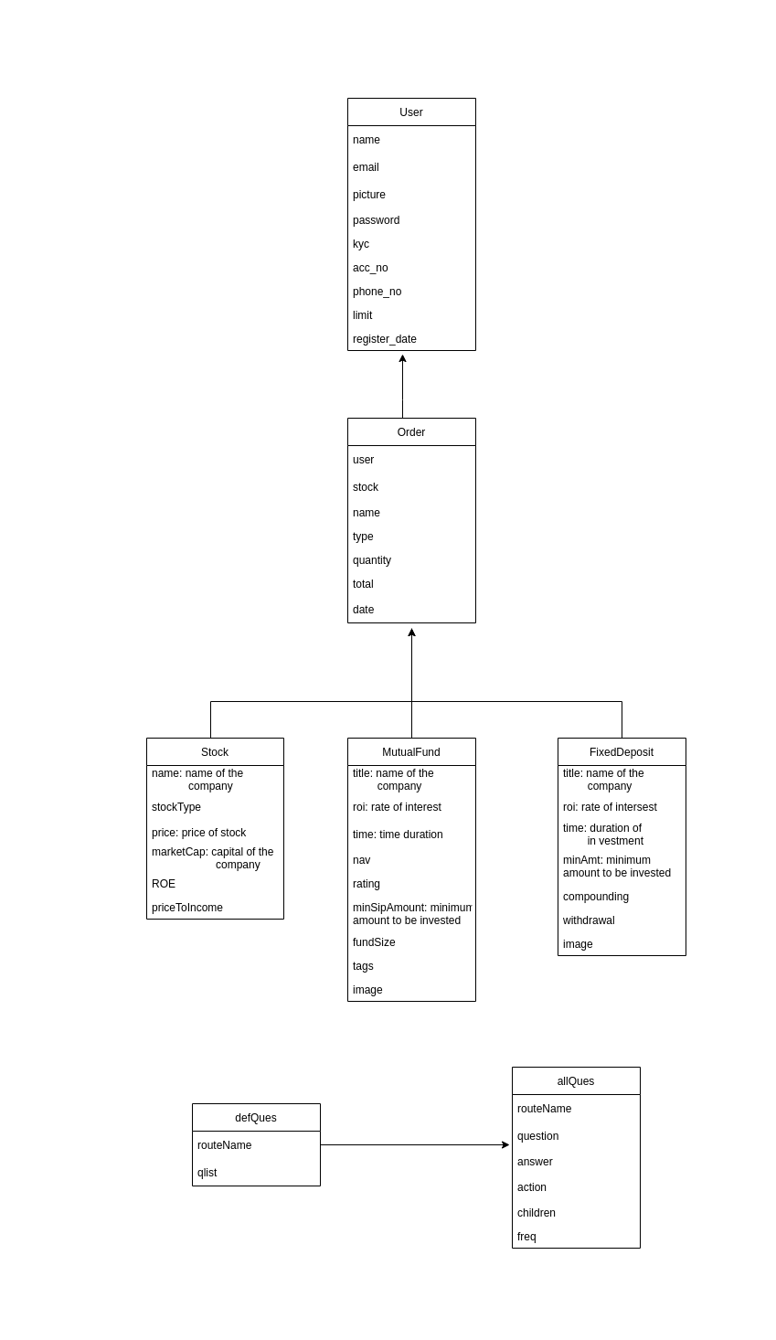

Slide 7
Thank You

